Slide 1
PBL – Project HOUSE HOLD TRASH DETECTING DRONE VIA IMAGE RECOGNITION
FY B.tech -IT
Semester -II ( 2024-25)
Name | Roll no
Varun Nair | 16010424088
Samriddha Pahari | 16010424089
Aarushee Pandagare | 16010424090
Aditya Pandey | 16010424091

Slide 2
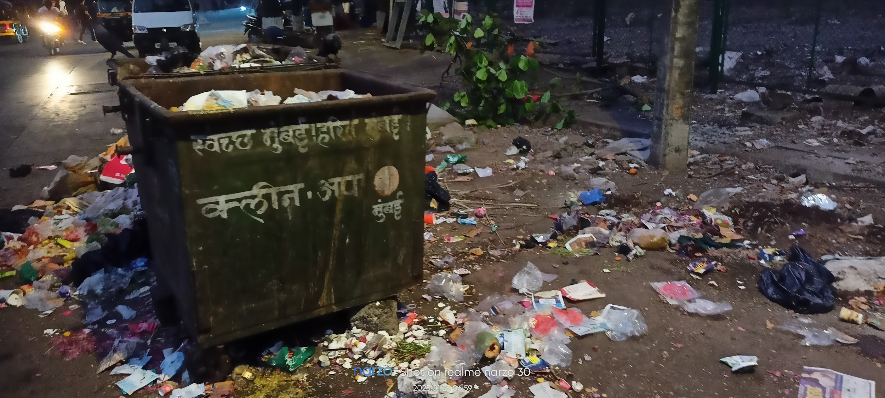
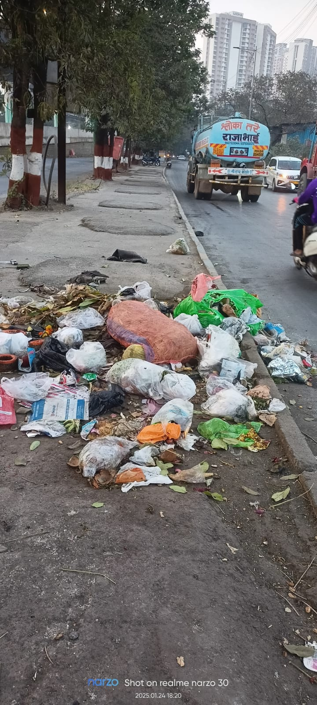
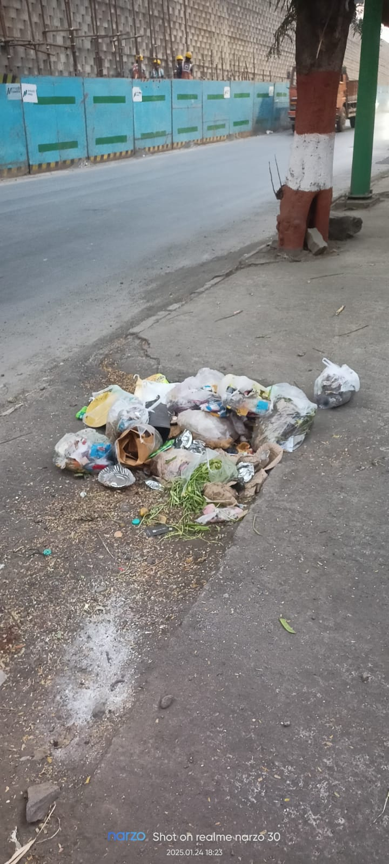
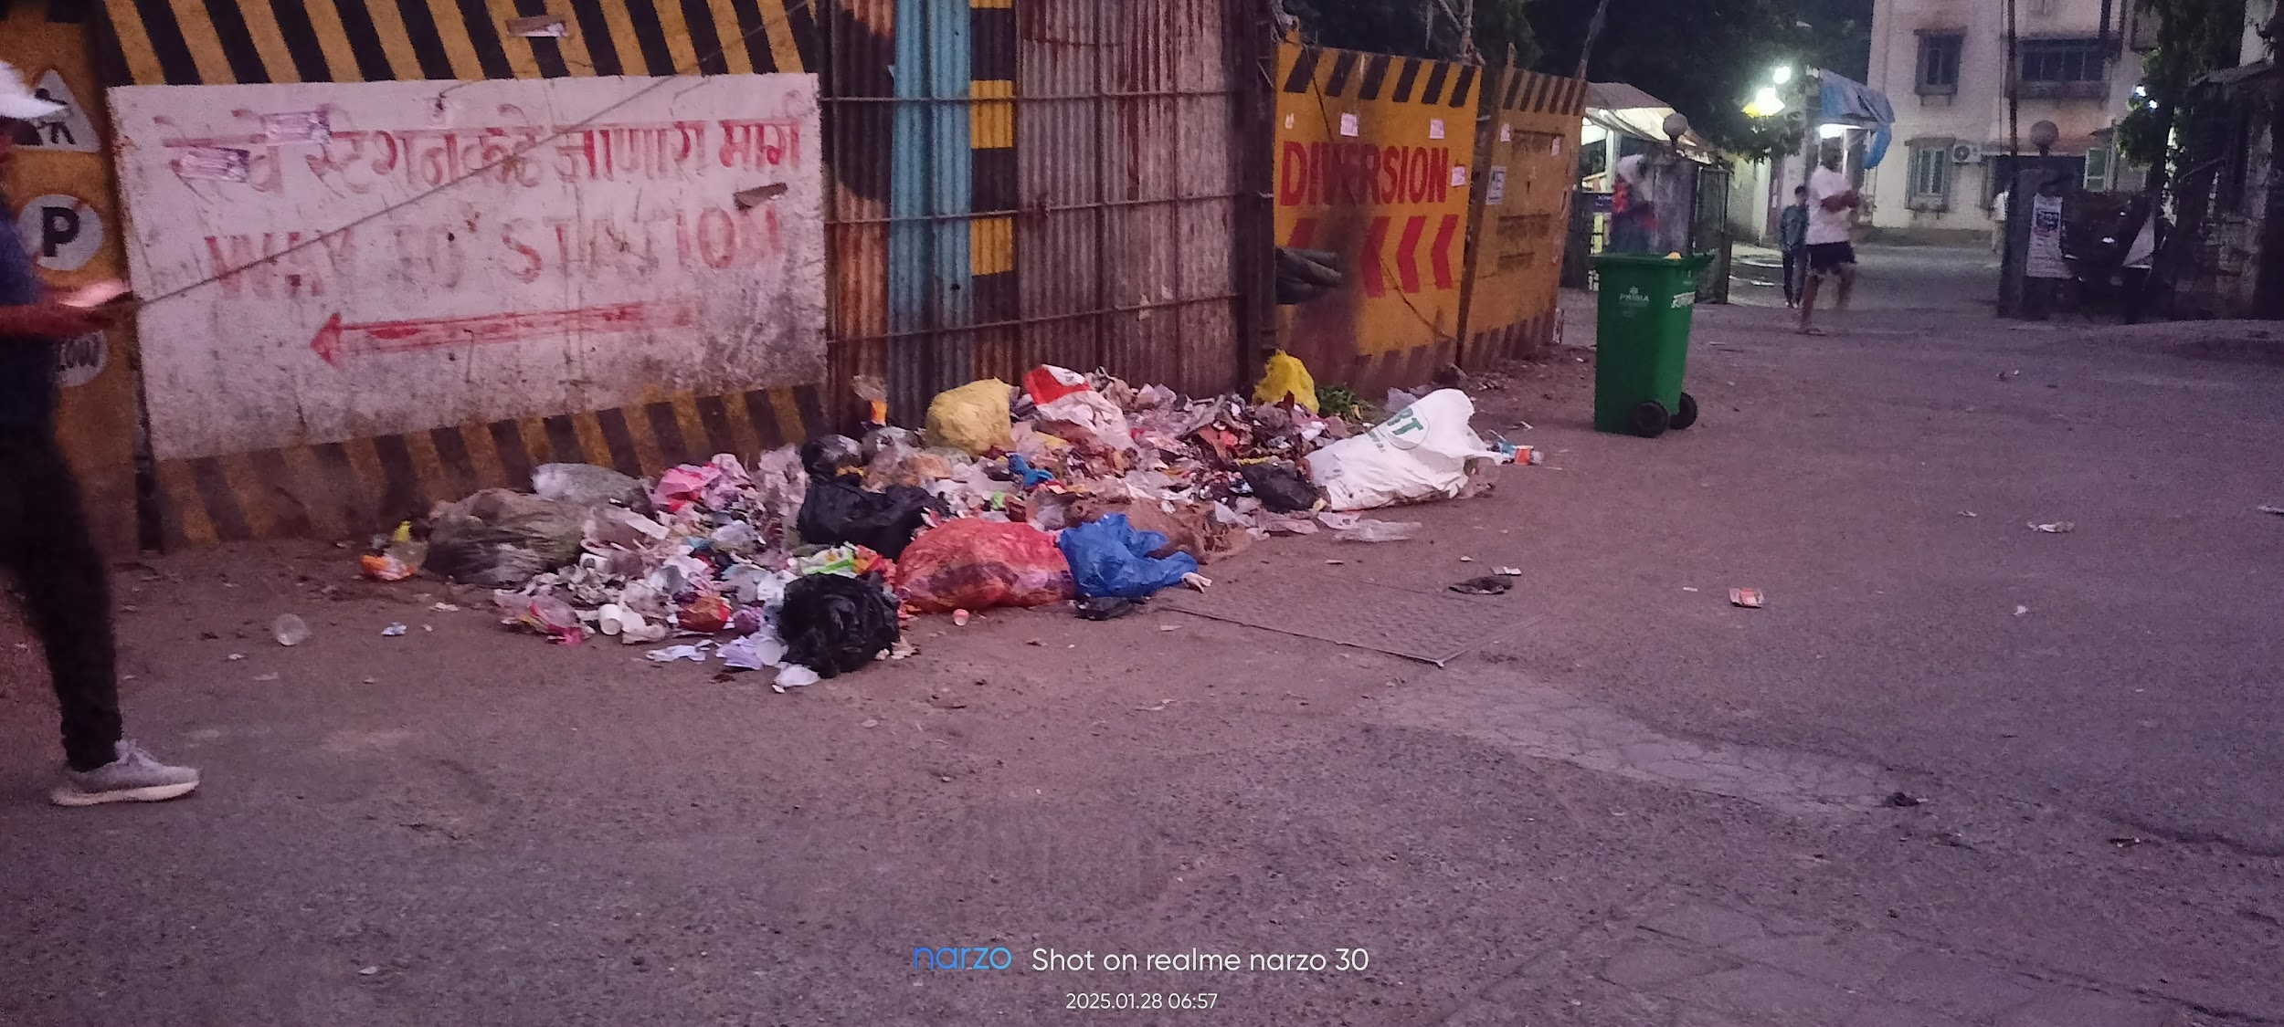
Theme chosen for Project
Street Trash Detecting Drone

Slide 3
Need Statement
There is a need for an autonomous drone-based system to detect and monitor street garbage in urban areas to improve waste management efficiency. The current manual detection process is time-consuming, labor-intensive, and often ineffective, leading to environmental pollution, clogged drainage, public health hazards and prevent animals from eating the plastic (Cows and dogs). A smart drone equipped with AI-powered image recognition can help municipal authorities identify garbage hotspots, optimize waste collection routes, and ensure cleaner streets, contributing to a healthier and more sustainable urban environment.

Slide 4
Problem Statement
List of objectives – Prevent contamination and reduce the spread of diseases caused by insect breeding.
Protect animals from consuming plastic and other harmful waste.
Enhance the of social workers during cleanup projects.
Streamline waste detection and collection for faster and more effective cleanup efforts
Constraints – Money, Weather, Aerial Obstacles
Functions – Live image detection of the garbage and Beeping when garbage is detected
Final Problem Statement - Open garbage on streets leads to contamination, creates breeding grounds for insects, and poses a serious risk to animals that consume plastic waste. This issue arises due to improper waste disposal, as many areas lack accessible garbage bins, causing people to discard household waste on the streets. To address this, an AI-powered drone can be deployed to detect and locate garbage hotspots, enabling municipal authorities and social workers to efficiently manage waste collection and maintain cleaner urban environments.

Slide 5
Hardware / Software Requirements
Hardware | Software
CP2102 | OPEN CV
MPU 6050 | ESP 32
TP4056 | YOLO
4148 Diode | Roboflow
Slide Switch
JUMPER WIRES (M-M, F-M)
ESP 32- CAM MODULE
3.7 V BATTERY (DRONE)
720 Coreless Motors
PCB
Propeller set
Motor driver
Buzzer
Bread board

Slide 6
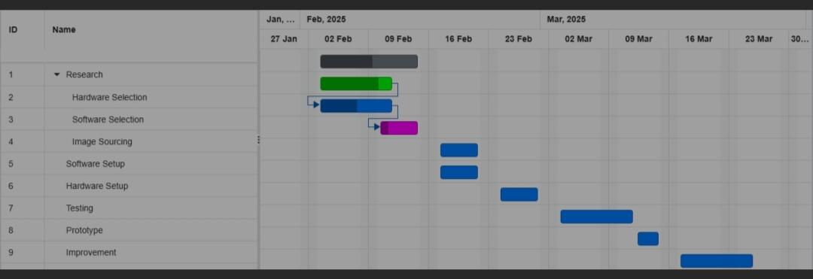
Time line Chart

Slide 7
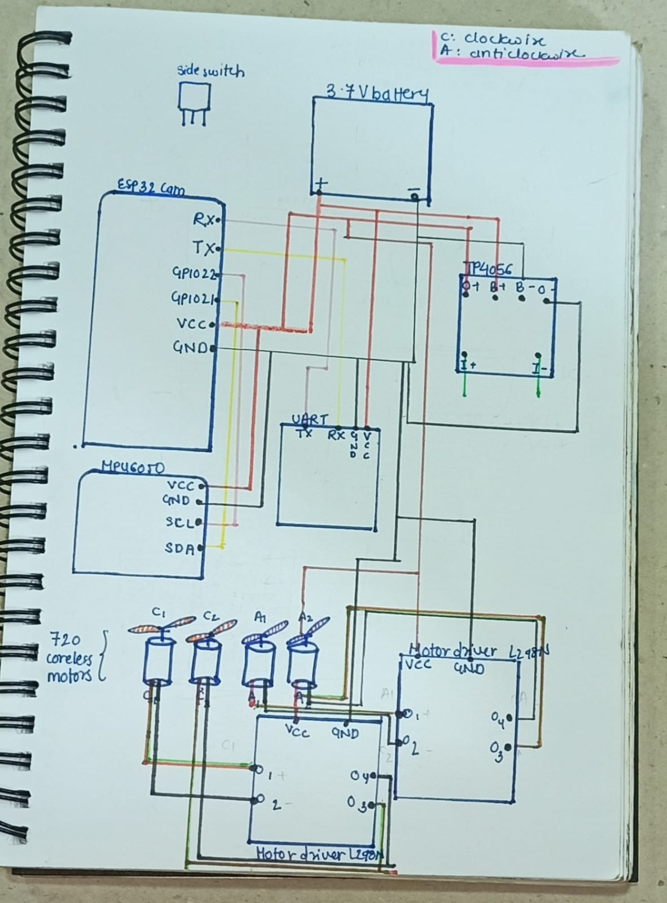
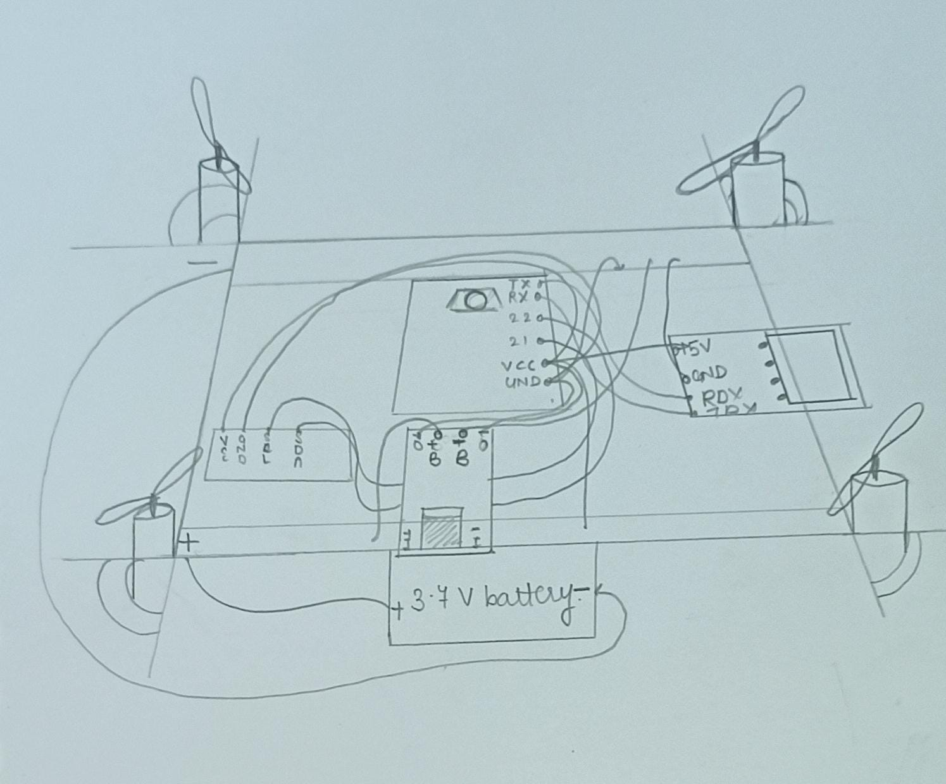
Conceptual Designs

Slide 8
Literature Survey
Title with year of Publication | Authors | Methodology/ Algorithms | Key Results / Findings | Remarks ( Based on your understating) | Link for article
11/06/2024 | Random nerd tutorials | Connecting DC Motors to L298N using M-M jumper wires. | We will have to use 2 l298N boards for our quadcopter | Easy to understand the basic connection | https://randomnerdtutorials.com/esp32-dc-motor-l298n-motor-driver-control-speed-direction/
Not mentioned | Random nerd tutorials | Training the Esp32 Cam for image processing | We have not explored it yet. |  | https://randomnerdtutorials.com/esp32-cam-video-streaming-web-server-camera-home-assistant/

Slide 9
Not mentioned | Random Nerd Tutorials | Connecting Battery with Esp32 Cam using M-M jumper wires | We will have to use voltage regulators and maybe use one more battery. | - | https://randomnerdtutorials.com/power-esp32-esp8266-solar-panels-battery-level-monitoring/
Not mentioned | Random Nerd Tutorials | Connecting IMU with Esp32 Cam and programming it. | We will use specific colour wires designated for coding and use Uart for connecting. | Esp32 cam module has different GPIO pins compared to esp32 Module. We will have to do more research for the same. | https://randomnerdtutorials.com/esp32-mpu-6050-accelerometer-gyroscope-arduino/
22/03/2024 | Jobit Joseph | Making a cost effective drone using readymade PCB and and DC motors with 55mm Propellers | We can make that drone! | Cost differences occurred and drone parts are banned. | https://circuitdigest.com/microcontroller-projects/DIY-wifi-controlled-drone

Slide 10
Block Diagram of Project
Household Trash Detecting drone
MPU 6050 – Provides balance and has inbuilt accelerometer
ESP 32 Cam module – The brain of the entire drone
YOLO,OpenCV – Allows the Board to analyze the picture as seen in camera
TP 4056 – Helps in safe and efficient charging of lithium ion batteries
Control the buzzer when image is detected.
720 coreless motors – Gives the required amount of thrust for the drone to fly
Motor drivers – Helps in controlling the motors instructing each motor
10

Slide 11
Project Cost Sheet
Parts name | Specifications | Cost (Aprox)
CP2102 UART X1 | Bridges USB and UART interfaces | 185
MPU60650X1 | Motion tracking device (imu) | 225
TP4056 X1 | Battery charger | 32
Slide switch | Helps in turning on/of the drone | 10
4148 Diode x4 | Power supply and motor control circuit | 8
Jumper Wires (M-M, F-M) x20 | Used for making connections | 25
ESP 32-CAM Module x1 | Acts as the main brain of the drone | 550
3.7V Battery (Drone) X1 | Provides power for the components to work inside | 300
720 CORELESS MOTOR X4 | Provides thrust to the entire drone helping it lift | 250
PCB 2x3 X1 | Provides electronic connections between components | 10
PROPELLER SET (55mm) X2 | A propeller generates thrust to lift and move the drone. | 70
MOTOR DRIVER X1 | Helps in controlling the motor | 100
Buzzer X1 | A buzzer gives sound alerts. | 15
Bread Board X1 | A breadboard is used to build and test circuits | -
Others |  | 60
Total |  | 1840

Slide 12
Proposed Circuit / Connection Diagram

Slide 13
Project Status
Work Completed till Date
Few components: L298N motor drivers and battery charger are remaining to be attached. 30% of the hardware part is completed.
Such as:
Circuit Diagram
Frame Work
Assembly of parts
Work To be completed
Software: Programming of ESP32 Cam with MPU6050, L298N, TP4056
Increase epoch to 50 for further training.
Connecting the ESP32-Cam module to Arduino IDE without failure

Slide 14
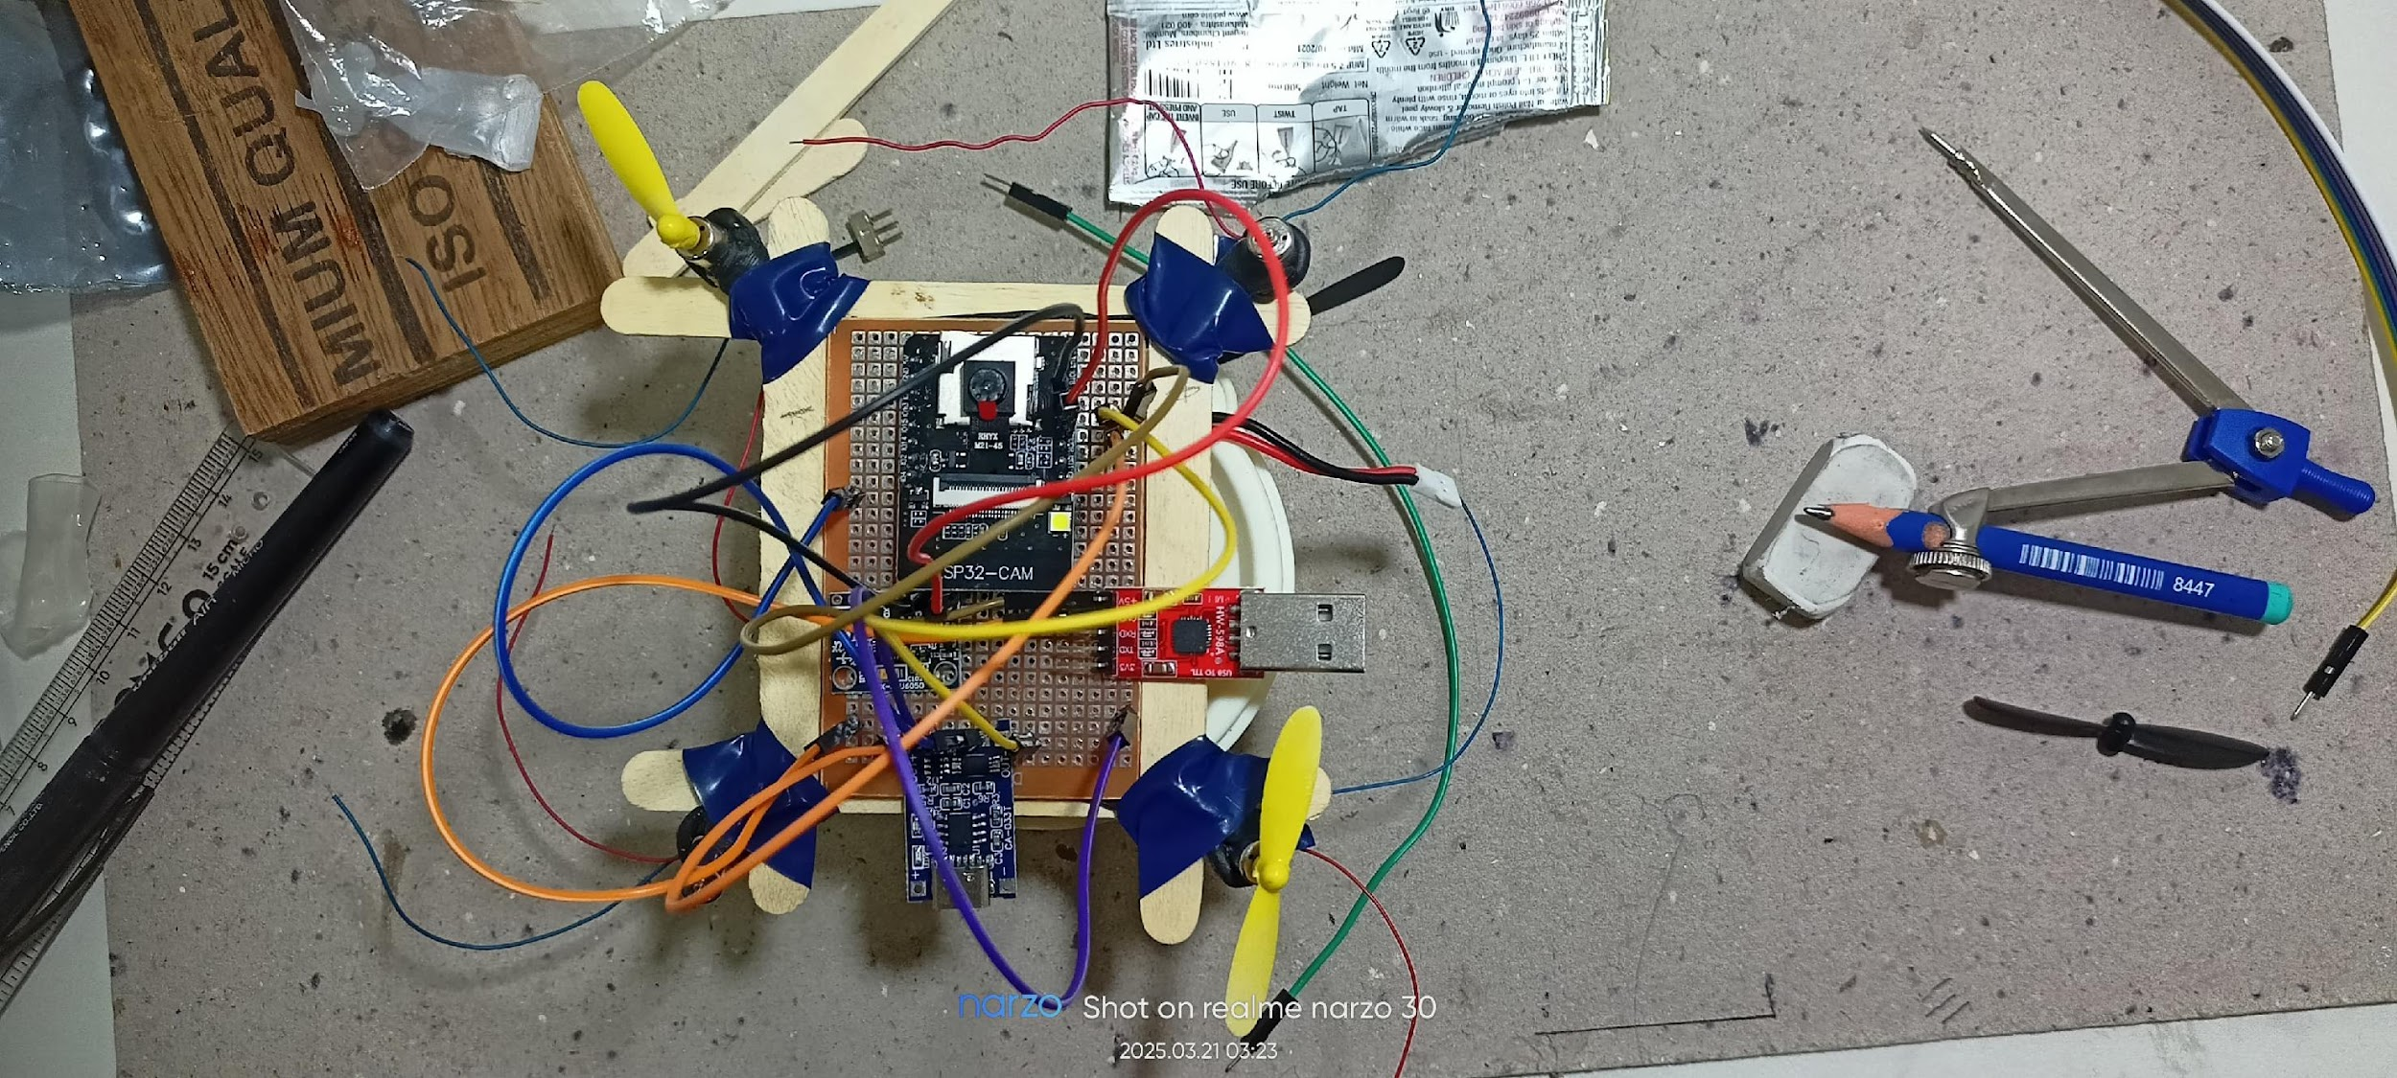
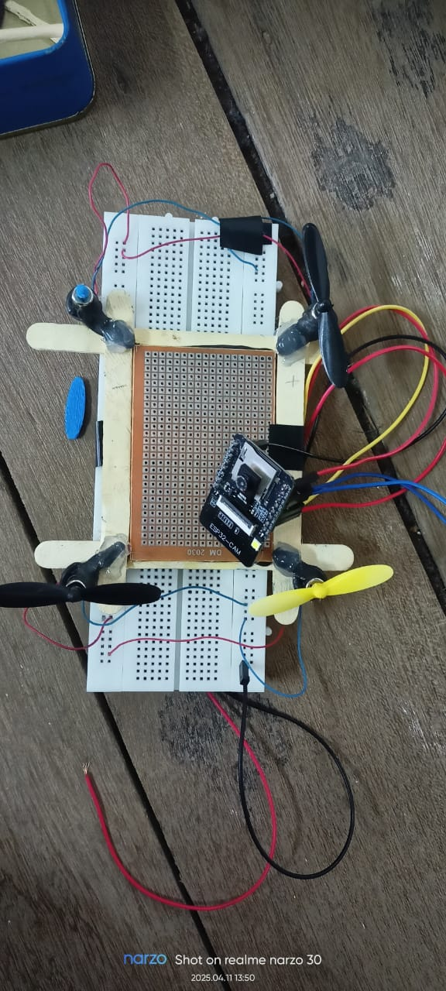
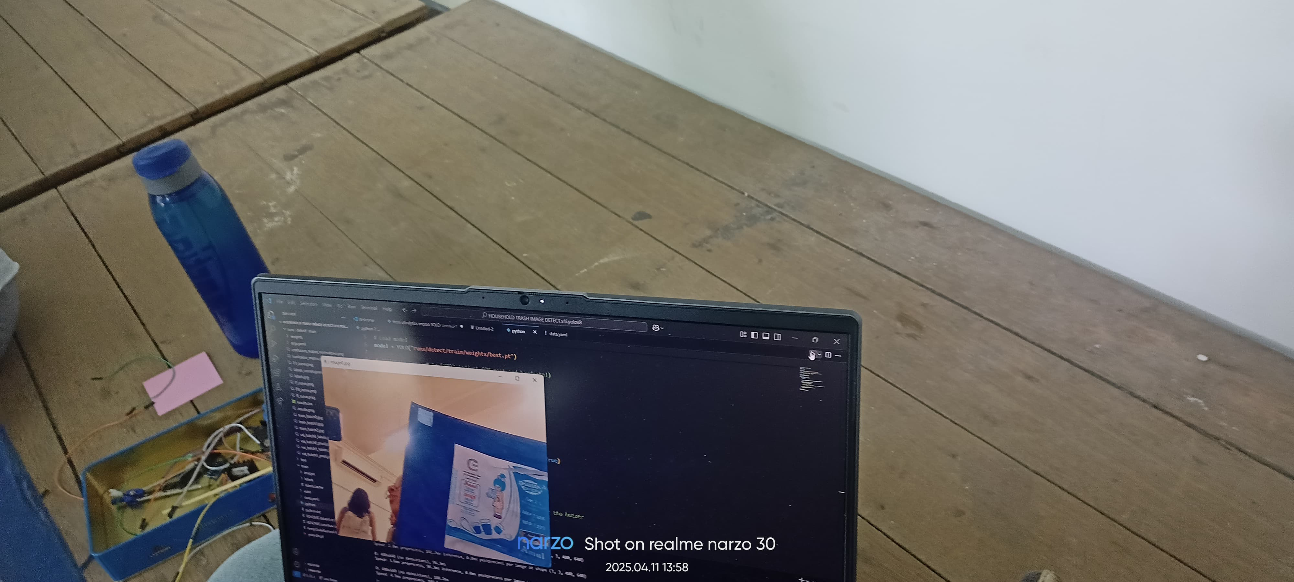
Results

Slide 15
Video Link (Drive)
https://drive.google.com/file/d/1sd36WH1DxfNUodX4LO99AANzWV8UiPy6/view?usp=drive_link
https://drive.google.com/file/d/1m87tP-JAseUlWk_KbbWGhg3M0qqW1d5Q/view?usp=sharing

Slide 16
Results
Our image-detecting drone is designed to identify specific products, including Amul Milk, Peanut Packets, Frooti bottles, and egg shells. As soon as the drone processes the image frame through its onboard system, it activates a buzzing alert, signaling the detection of any of these items. Our drone will be controlled using an application on phone and the code will run on the laptop. Since our camera does not have a high resolution (budget limit) we have decided to stick to a particular type of trash.

Slide 17
Results
Objective / Function | Achieved / Not Achived | Remarks ( If Achived range or accuracy . If not achived , justify probable reason
The objective of a garbage-finding drone is to efficiently detect and locate plastic waste like amul packet, frooti bottle, peanut packet and egg shell.which is often found on streets. | Not achieved | Esp 32 cam module was not able to detect and take the input from Arduino ide webserver for IP address. Also the epoch being only 5 was not able to give best.pt of good value to be able to detect the images even though laptop web cam opened.

Slide 18
References
Research papers on AI-based garbage detection, drone technology manuals, OpenCV and TensorFlow documentation.
PBL Teachers and Sirs ,Ninad Sir, Technical Councils. Seniors: Shreya T, Zephyr, Jeet Gada, Wajeed and Lyba, Nitisha (ISTE), and Classmates.

